Slide 1

ONITSHAMARKET.COM
SELLER’S GUIDE

Slide 2
TABLE OF CONTENT
SELLER ACCOUNT
Creating your account
Logging in
Changing account details
Changing your password
PRODUCTS
Adding new products
Managing products
ORDERS
What to do when product requested
Managing orders
REPORTS
Sales reports
ACCOUNTING
Account statement
Requesting payout

Slide 3
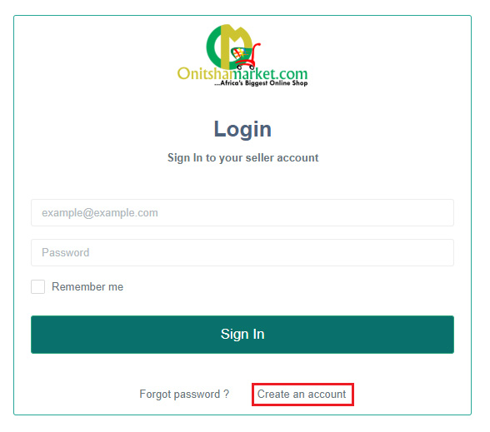
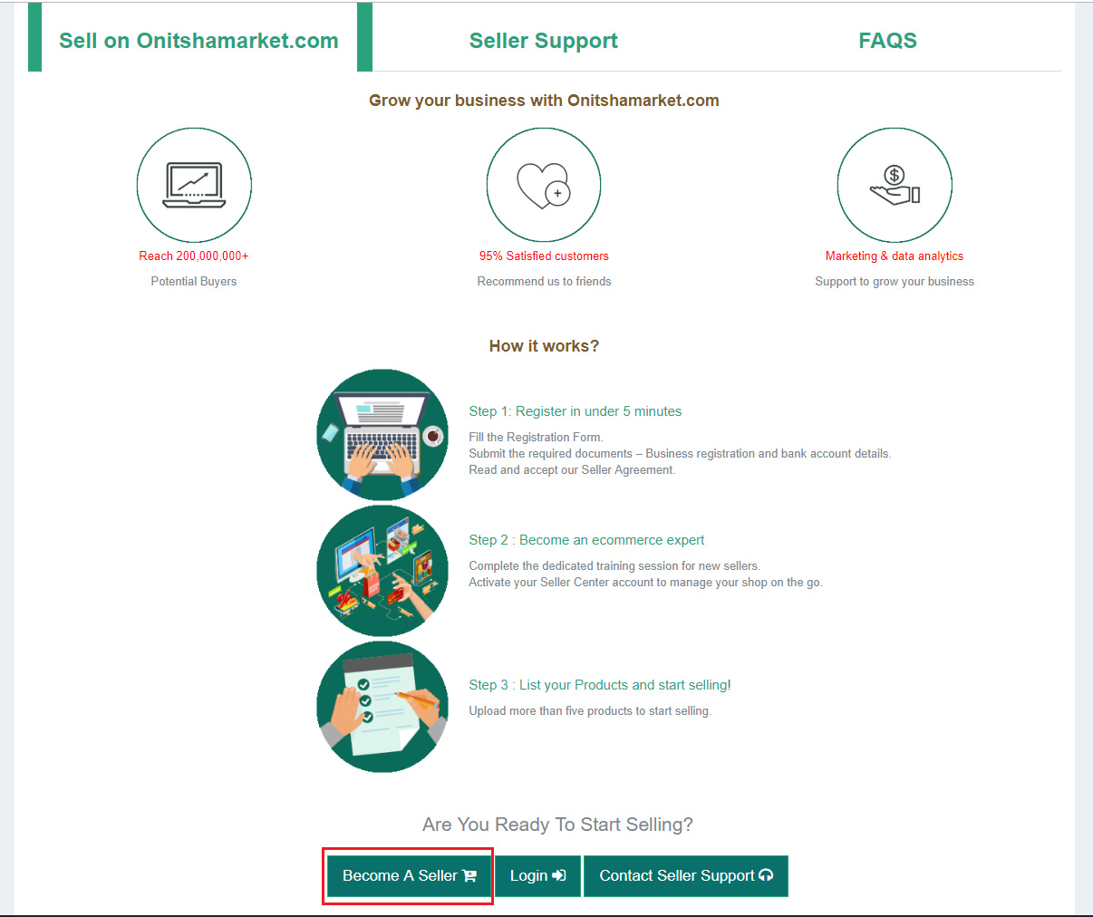
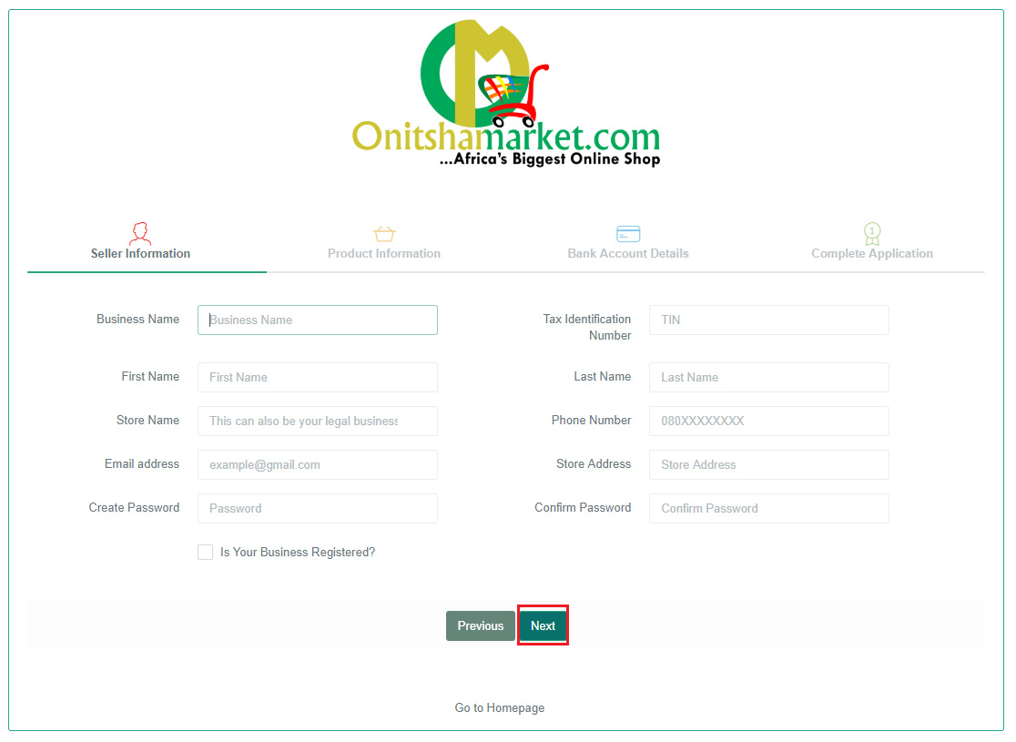
SELLER ACCOUNT
Creating Your Account
Navigate your browser to http://sellers.onitshamarket.com
Click on create an account
Read how it works and click on become a seller button at the end of the page
Complete the sign up form with correct details
Click on next after each stage

Slide 4
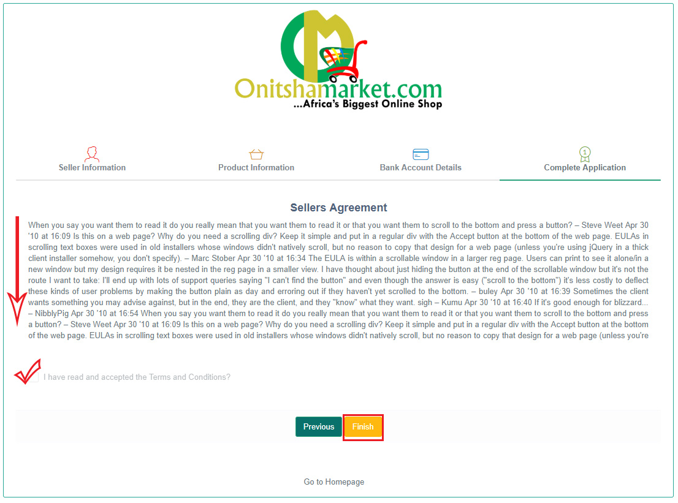
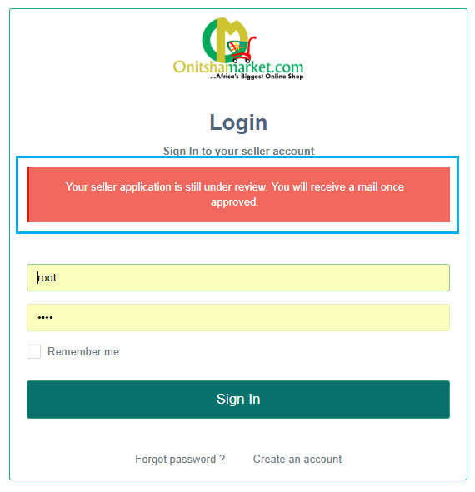
SELLER ACCOUNT
Creating Your Account
After clicking on next on bank details stage
Read the sellers terms to the end
Accept the sellers terms then click on finish
After this you wait for admin to approve you as a seller
You can't login without being approved

Slide 5
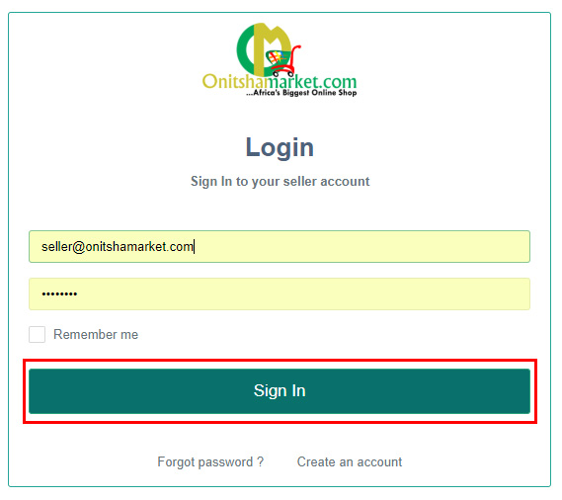
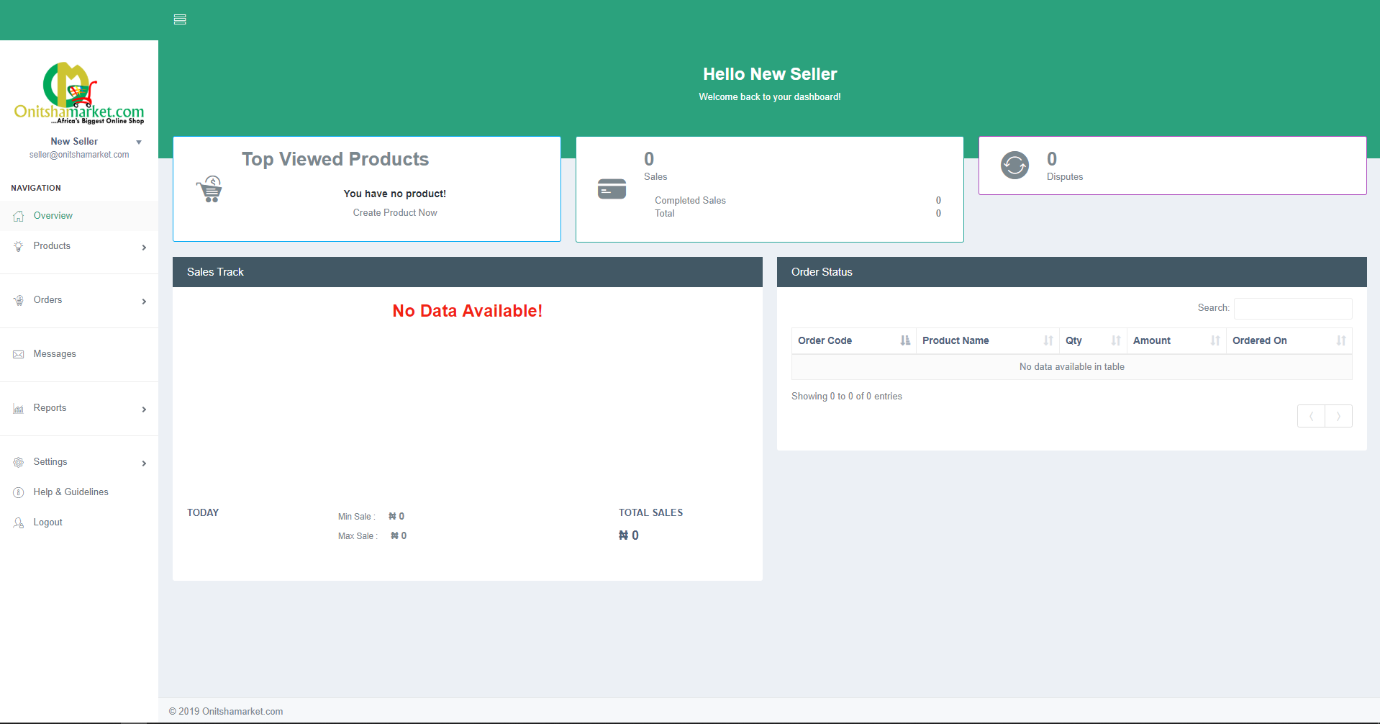
SELLER ACCOUNT
Logging In
Navigate your browser to http://sellers.onitshamarket.com
Enter your email and password in the form fields and click on sign in
Then you are redirected to your dashboard

Slide 6
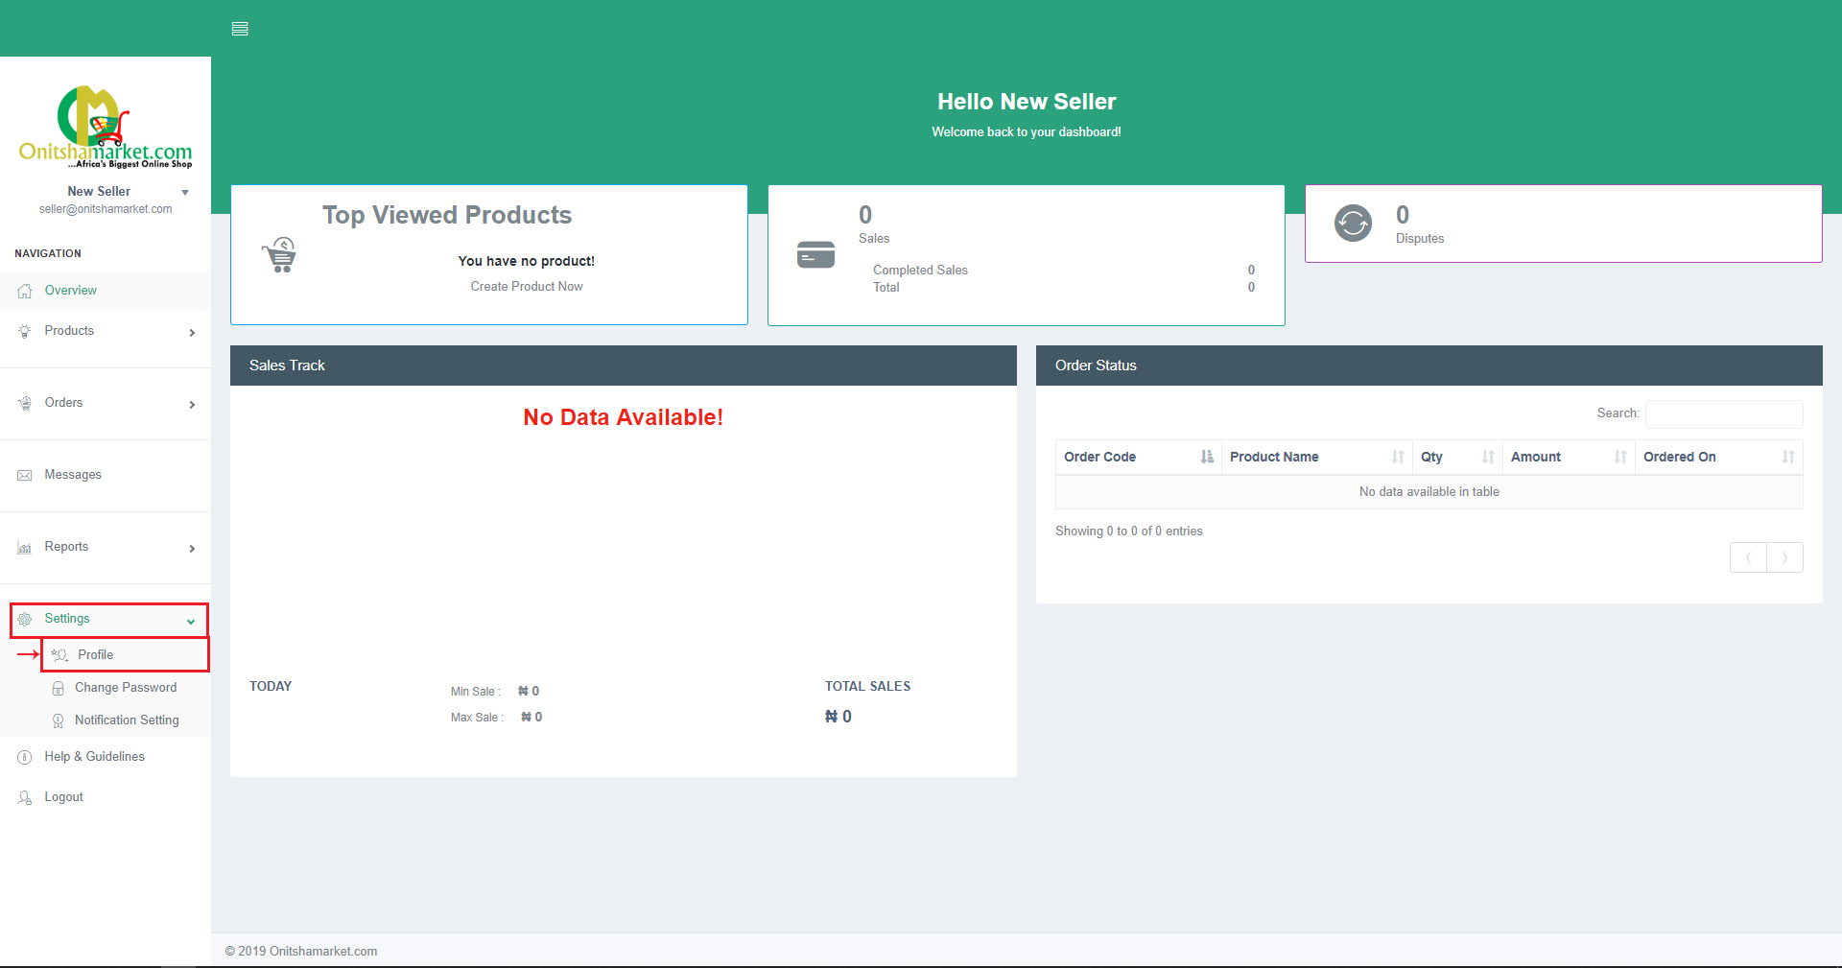
SELLER ACCOUNT
Changing Seller Details
After you have successfully logged in to http://sellers.onitshamarket.com
Select settings on the side menu
Then click on profile

Slide 7
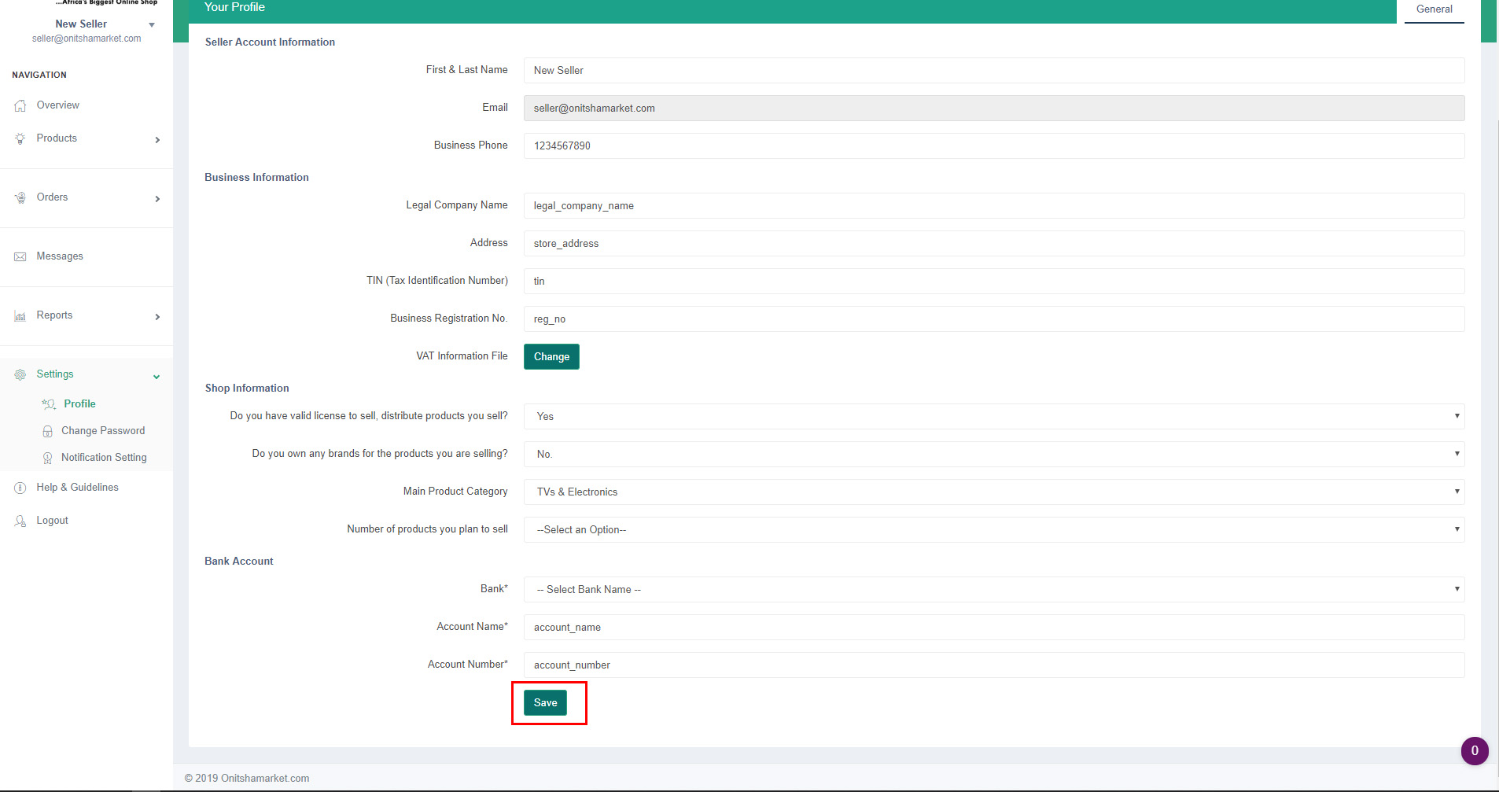
SELLER ACCOUNT
Changing Seller Details
You can now change any details you want to update
Then click on save button to update changes

Slide 8
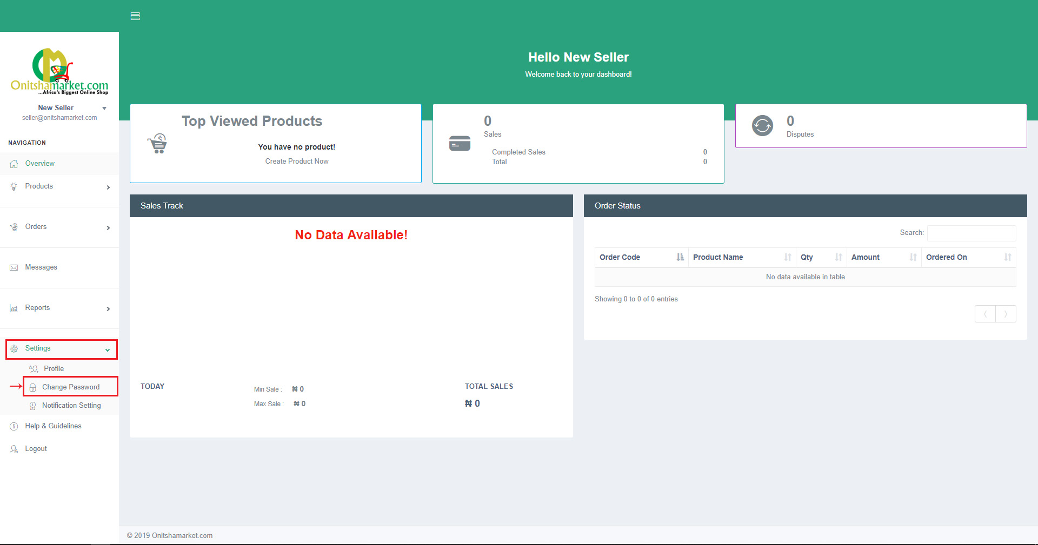
SELLER ACCOUNT
Changing Your Password
After you have successfully logged in to http://sellers.onitshamarket.com
Select settings on the side menu
Then click on change password

Slide 9
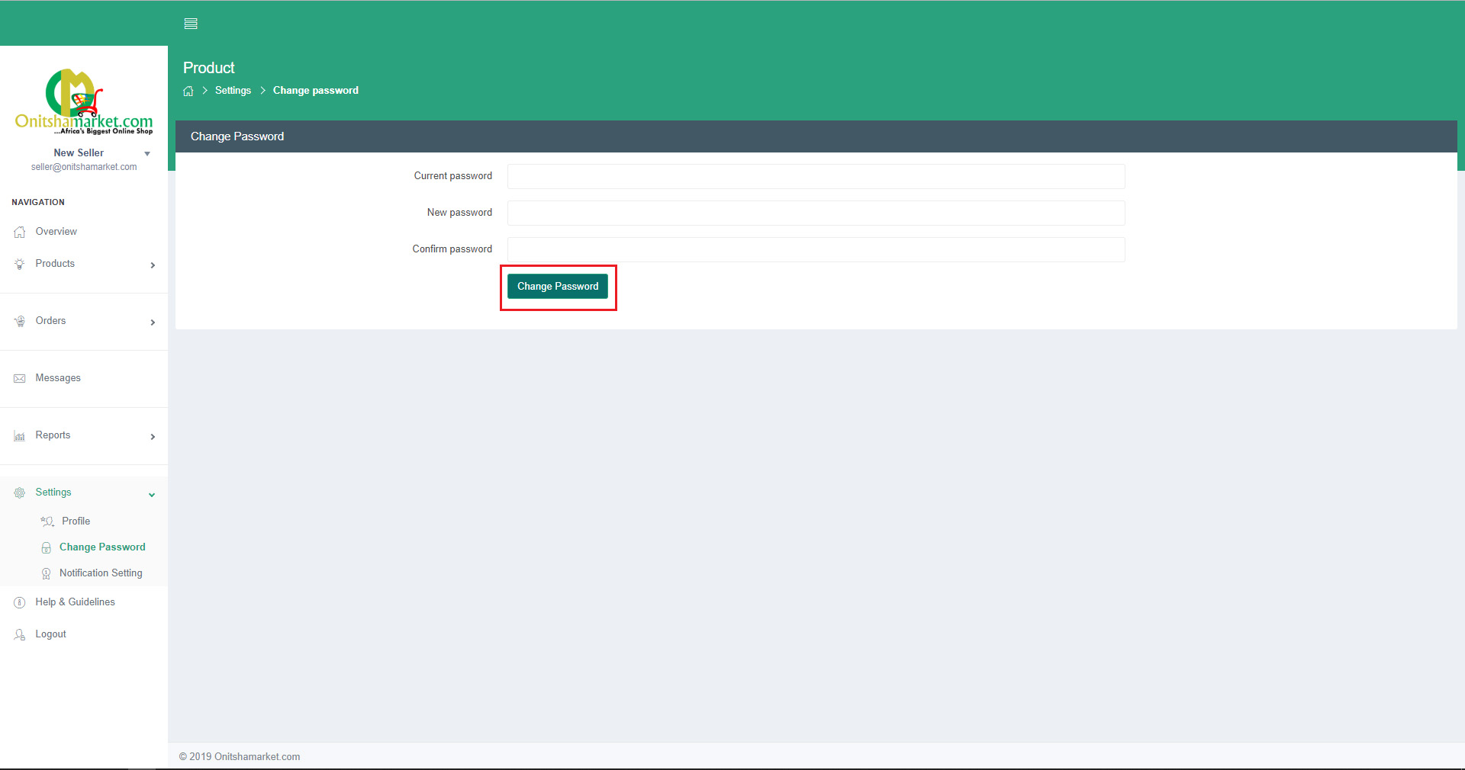
SELLER ACCOUNT
Changing Your Password
To change your password enter your current password
Enter the new password
Enter new password again for confirmation
Then click on change password button to update changes

Slide 10
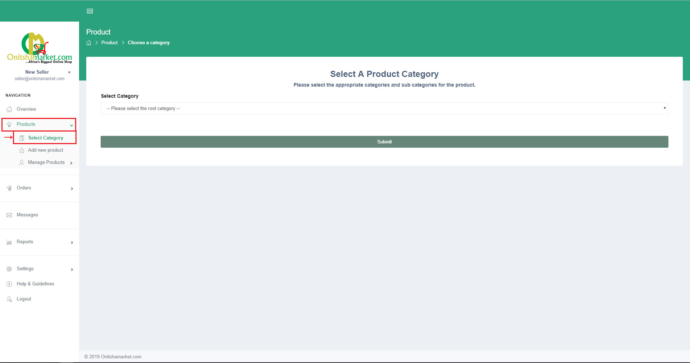
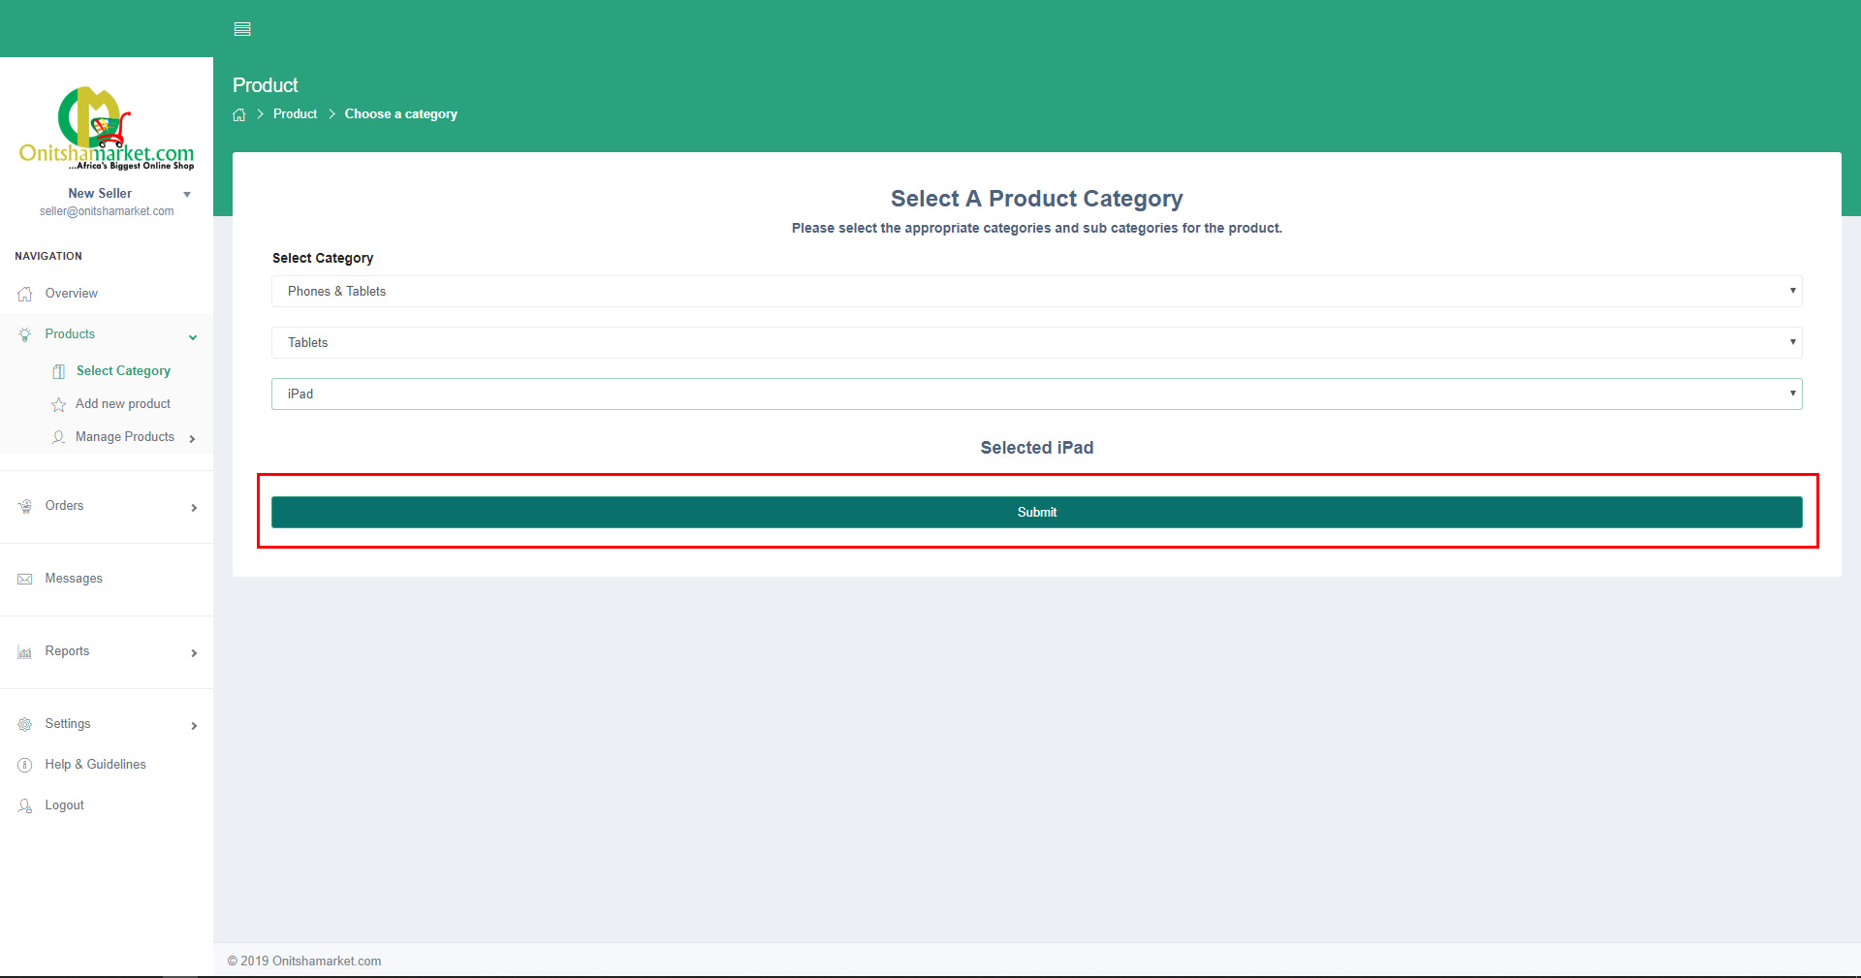
PRODUCTS
Adding New Products
After you have successfully logged in to http://sellers.onitshamarket.com
Select Products on the side menu
Then click on select category to start product creation
Select the root category which your product belongs
Click on submit after selecting category

Slide 11
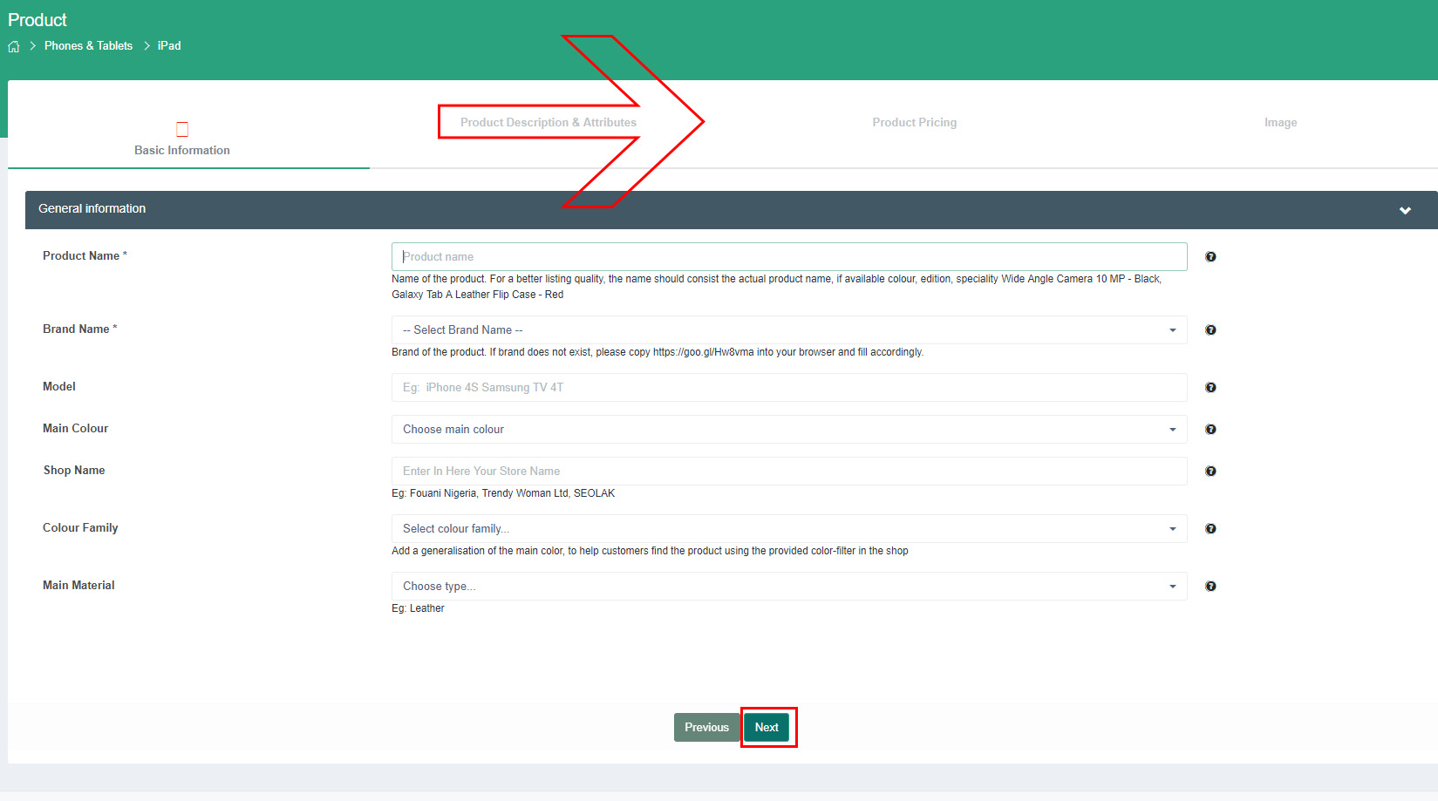
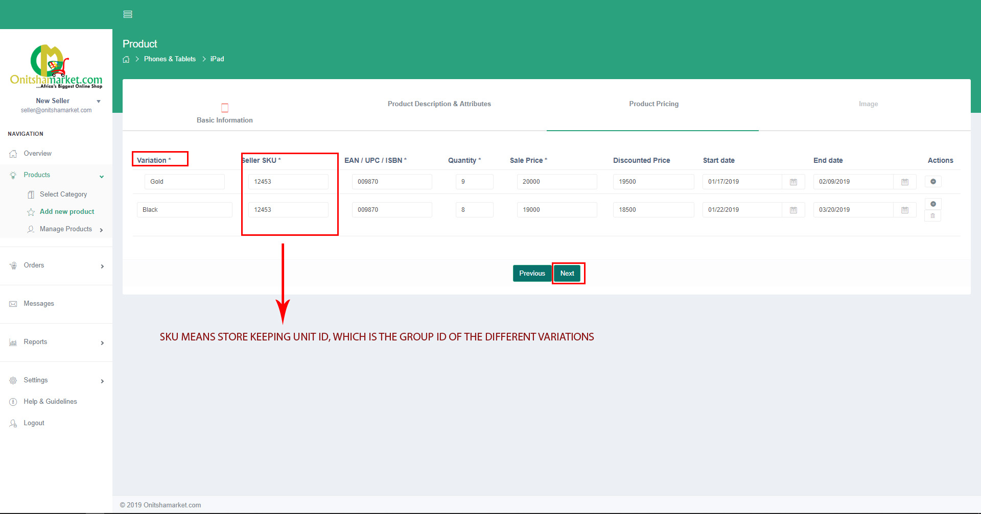
PRODUCTS
Adding New Products
Fill in the general information and click next
Complete the product specification and attributes form then click on next button
The product pricing form table: Please note;
if you only have one variant of your product then you require only one row on
the pricing table. But if there are more than one variations(colors, sizes, etc.)
then you require one row for each variation.
After completing the variations and pricing click on next button

Slide 12
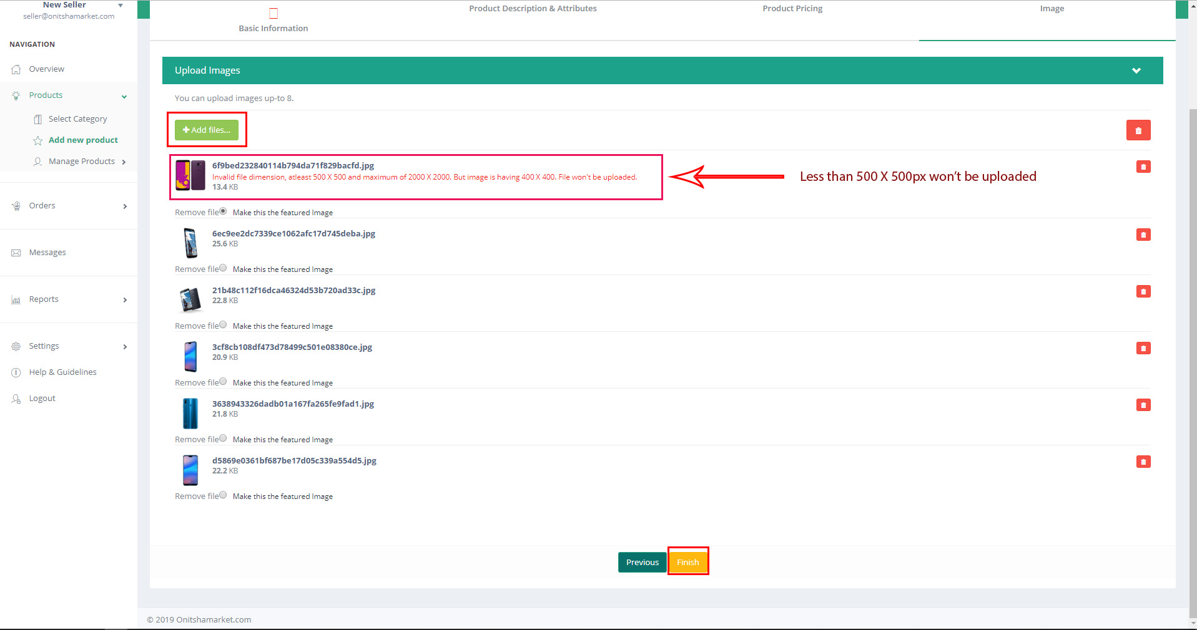
PRODUCTS
Adding New Products
Click on add files .
Select product images to upload, images must have white background, and at least 500 X 500px in dimension, maximum of 8 images allowed.
You can also select the image you want to be used as the main image in this part of the form.
Click on finish and await admins approval of the product, so that it can be seen by buyers.

Slide 13
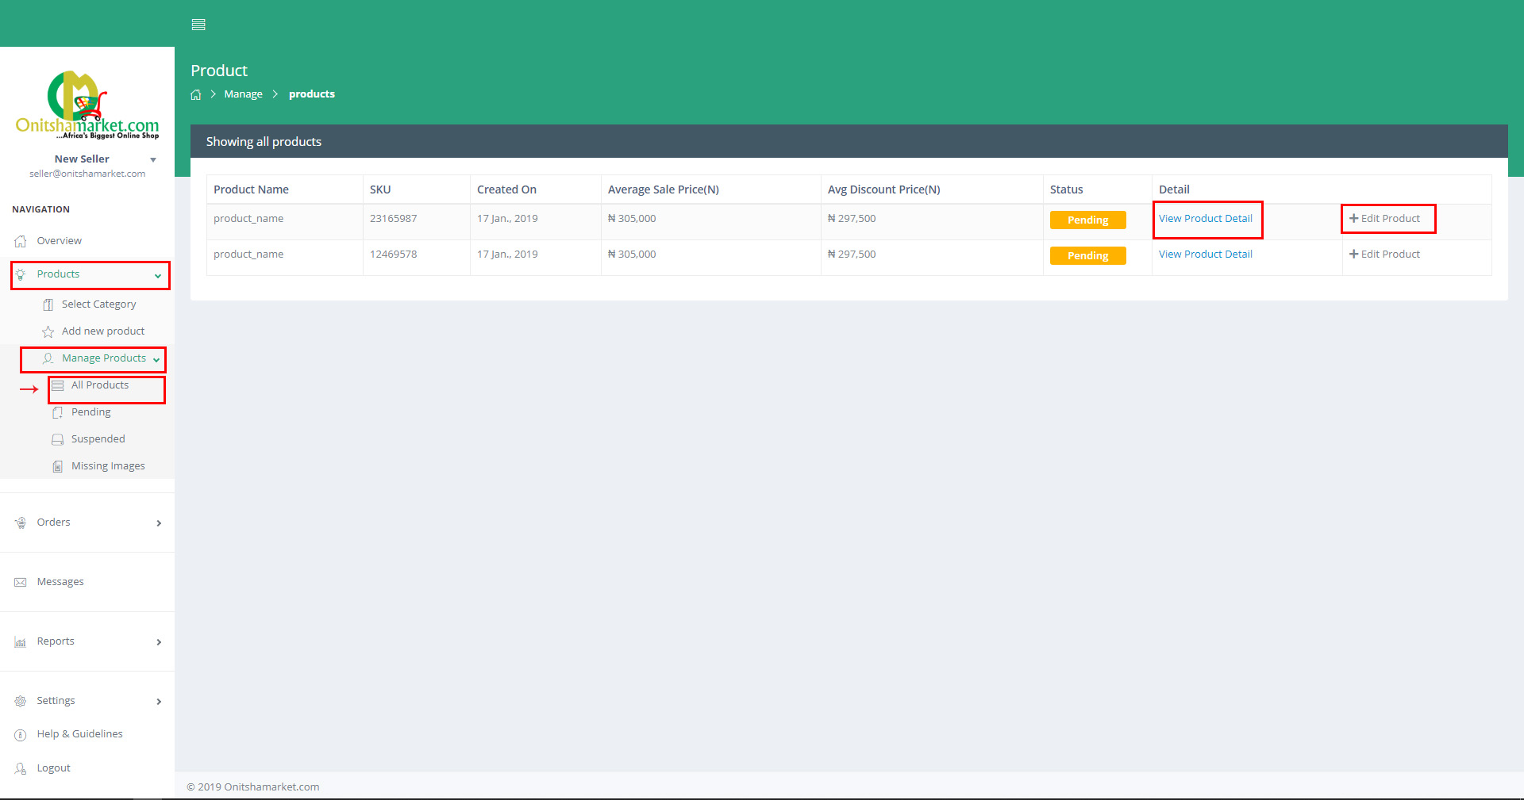
PRODUCTS
Managing Products
Click manage products under products option in menu.
Select all products
You will see a table containing all your products and there respective statuses
You can view product details by clicking on view product detail
You can also edit products details from this page

Slide 14
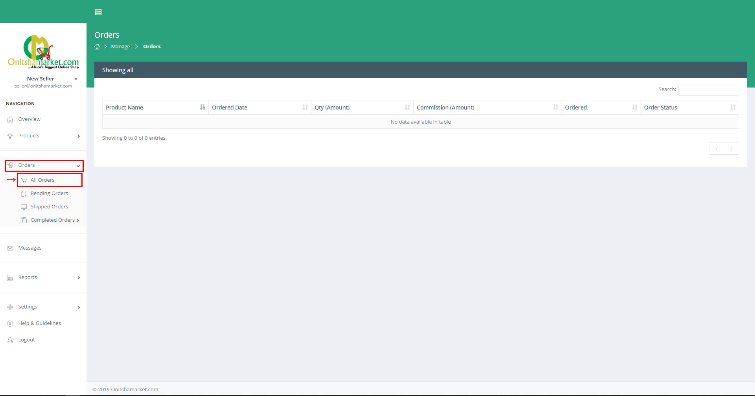
ORDERS
Order Received / Managing Orders
When a buyer places an order on your product, you will get a notification in your email and on your sellers dashboard of which products were ordered
You are then make provision for the products requested within 24hours.
You can also keep your products stored in our warehouse which eliminates your haste when order received.
After this steps you can keep track of the progress of your product ordered by clicking orders in the side menu.
Then you select all orders
You will be presented with a list of all your orders and each order’s present status

Slide 15
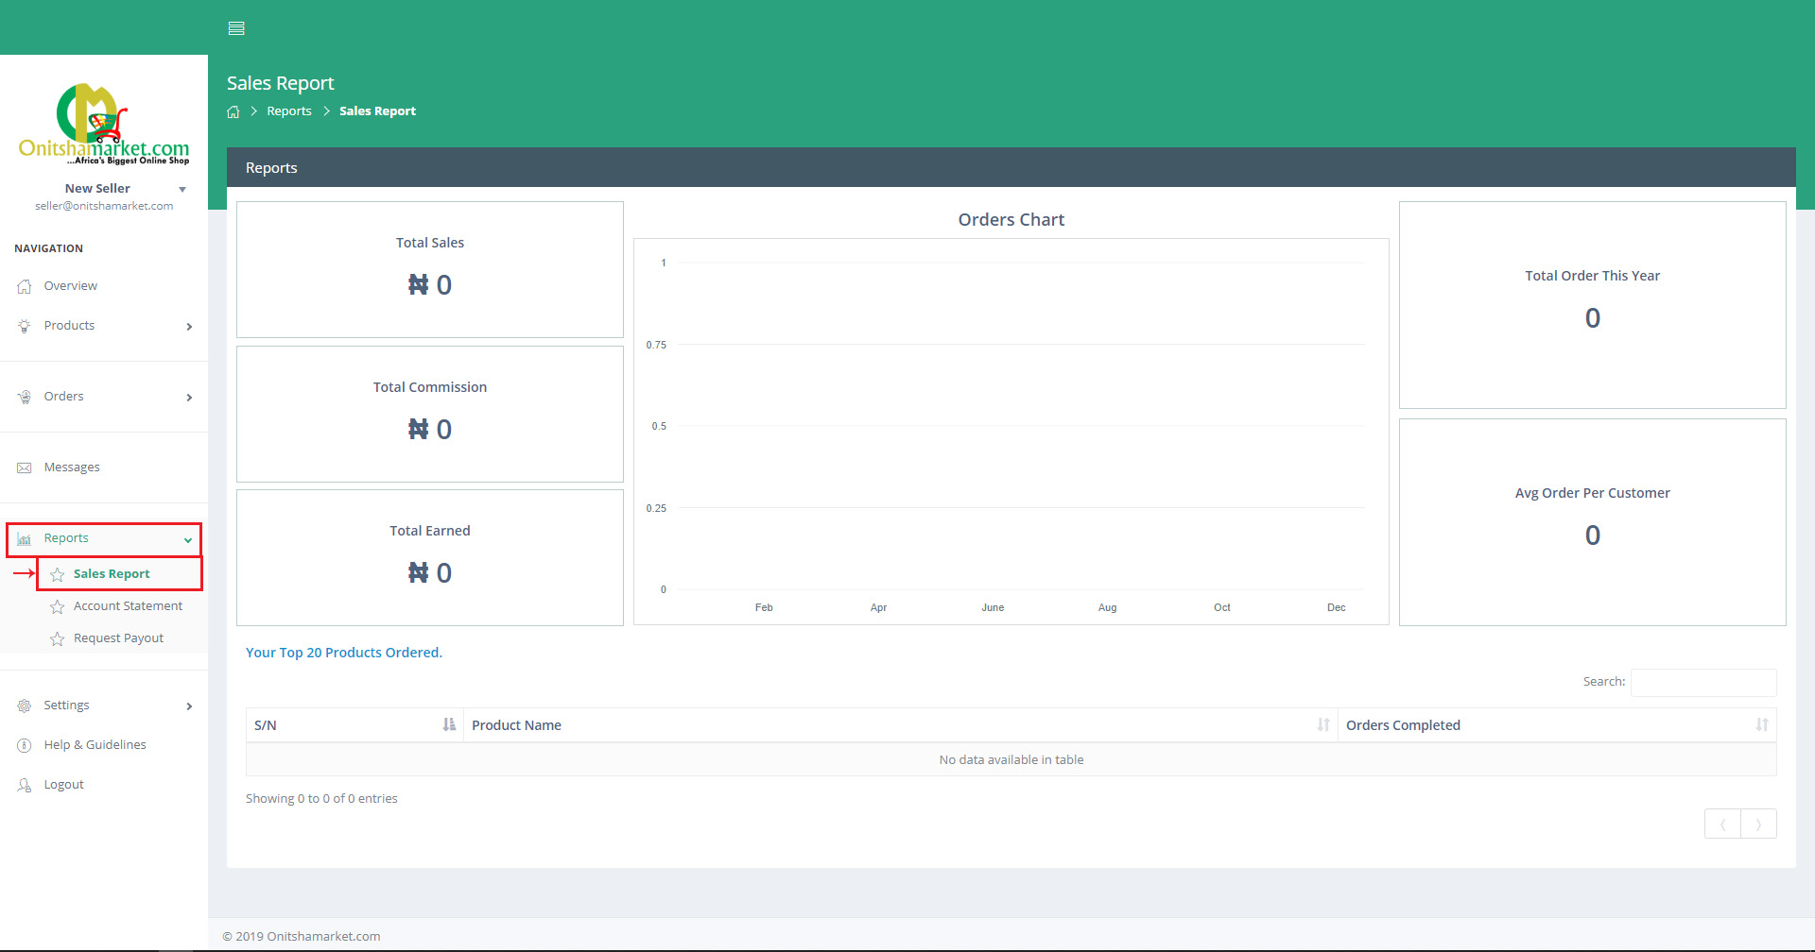
REPORTS
Sales Report
You can locate the reports menu in the side menu and you can view your sales progress by clicking on sales report
You can see how much total sales you made here as well as track all commissions charged by onitshamarket.com
You can also see your total balance with the system from this page

Slide 16
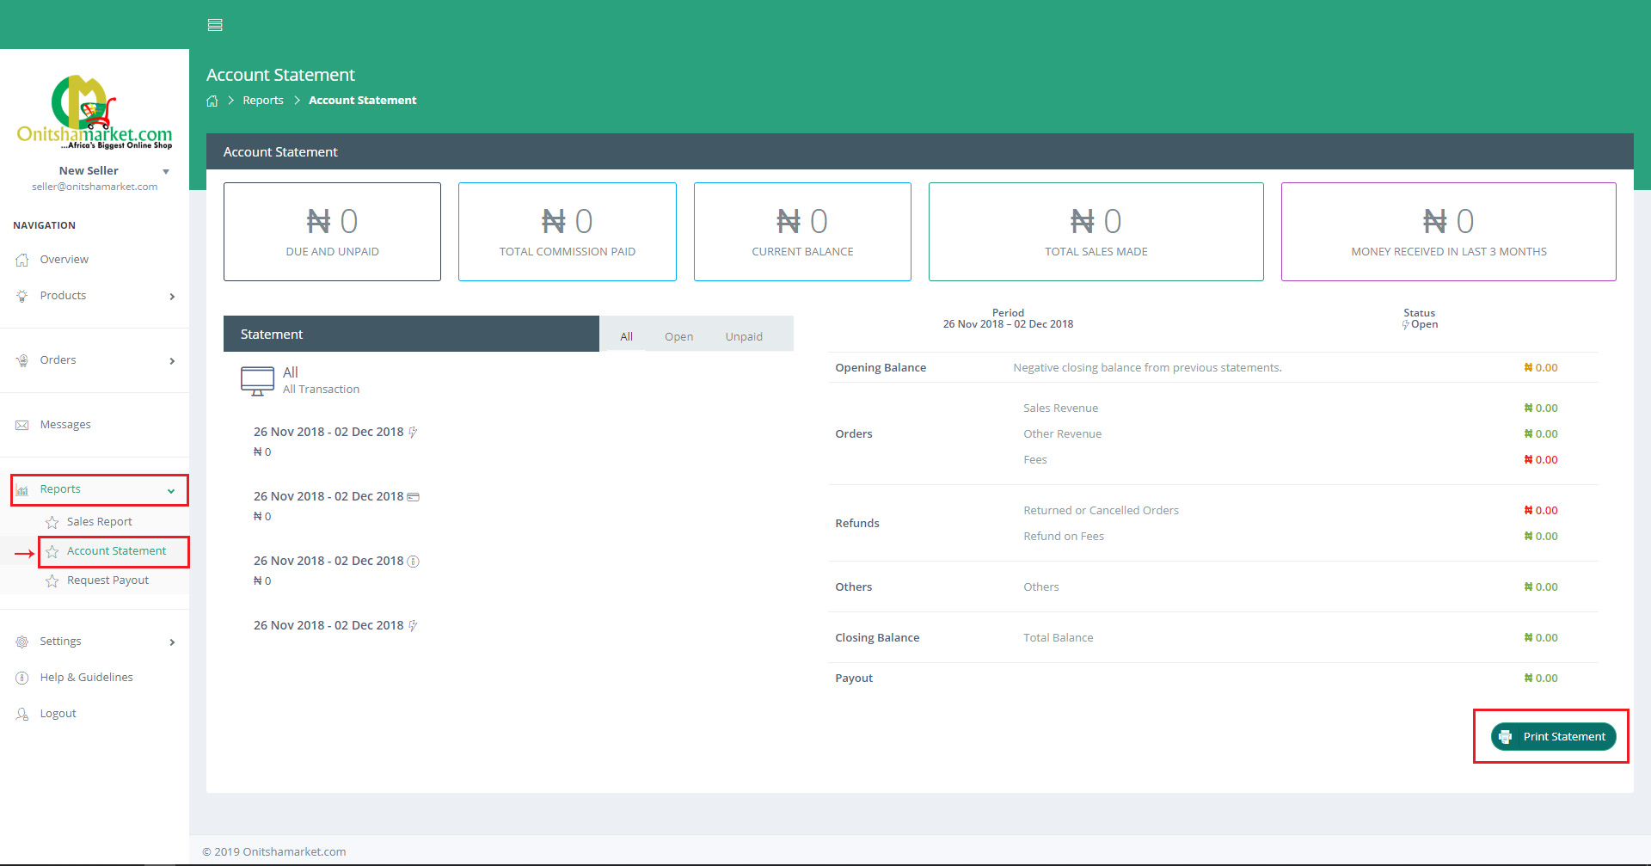
ACCOUNTING
Account Statement
You can find your account statement by clicking on account statement under the reports option in the side menu
Here you can track you’re your orders money
You have also have a record of all payments made for your products
You can also find your current available balance for withdrawal
You will also see the total commission you have paid to onitshamarket.com
You can as well print out a weekly summary of your payments from this page

Slide 17
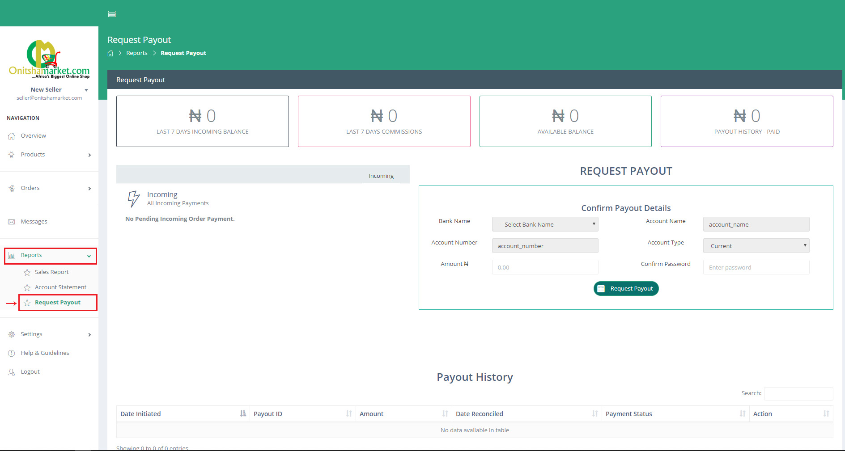
ACCOUNTING
Requesting Payout
To request a payment make sure you're logged in to your seller accounts
Click on reports in the side menu
Select request layout
Fill in the amount to withdraw, which must not be greater than your available balance and not less than #1,000
Confirm your password and click on request payout

Slide 18
ACCOUNTING
Requesting Payout
In the request payout page you can find the following information
Incoming cash from sales completed
Total commissions you paid to onitshamarket.com
Your cash available for withdrawal
Total amount you have successfully withdrew
History of all your previous successful withdrawals

